Slide 1


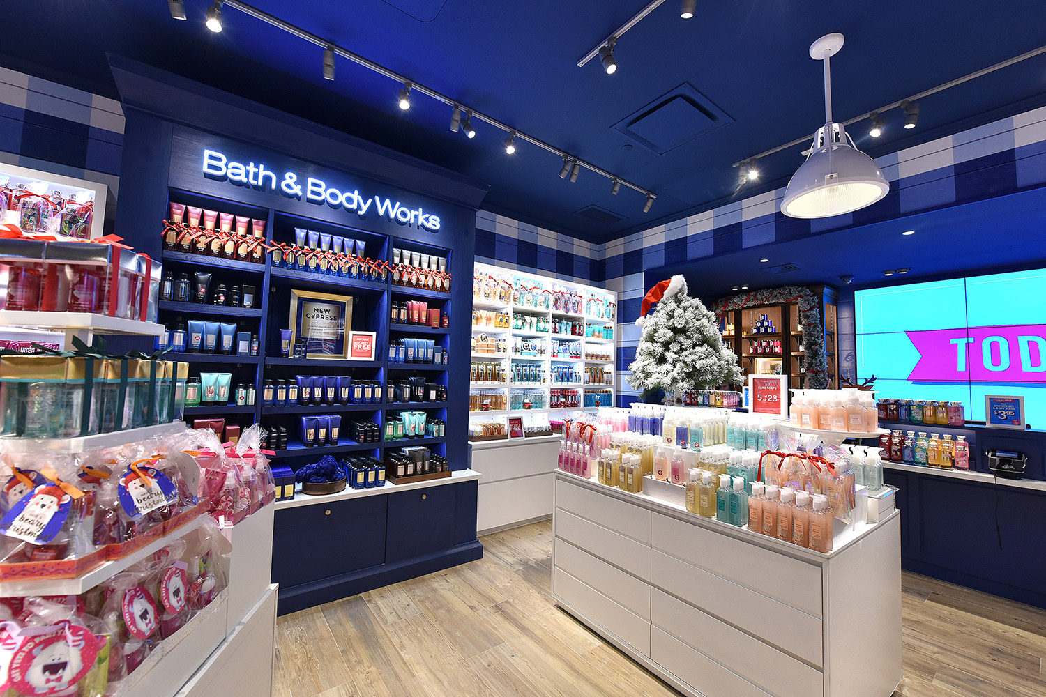

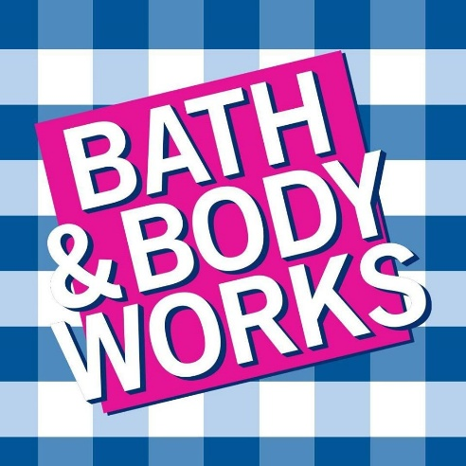

Feburary 26th 2025
BATH & BODY WORKS
POSITIONING ANALYSIS
MKT562 Advanced marketing analytics – Final Group Project
Presented by Group 7
Ayush Trivedi, Dhruv Shah, Kushal Patel, Neil Dilawari,
Sukanya Mane, Sravani Bolla, Tejaswini Nannapaneni

Slide 2



Contents
1
About our Company
6
Segmentation Analysis
2
About Competitors
Positioning & Market share Analysis
7
3
Comparison
8
Limitations
4
Survey Methodology & Findings
9
Key Findings
5
Survey Findings
10
Recommendation

Slide 3

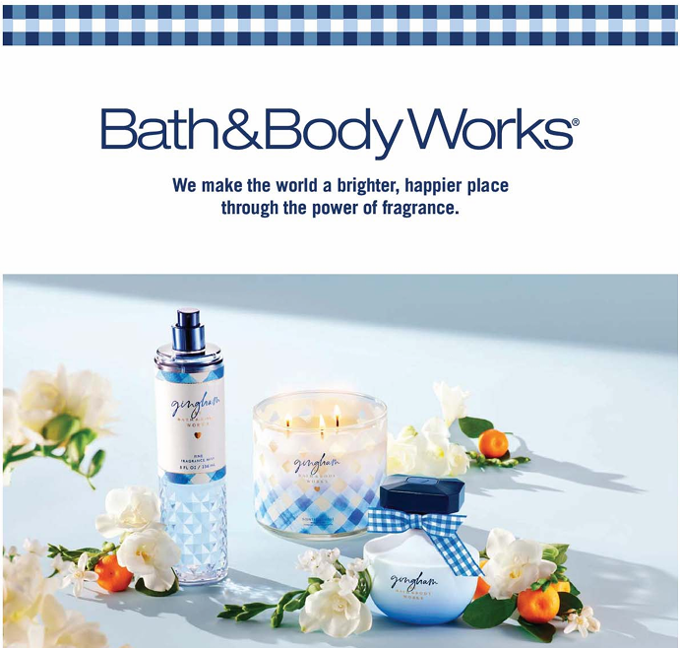
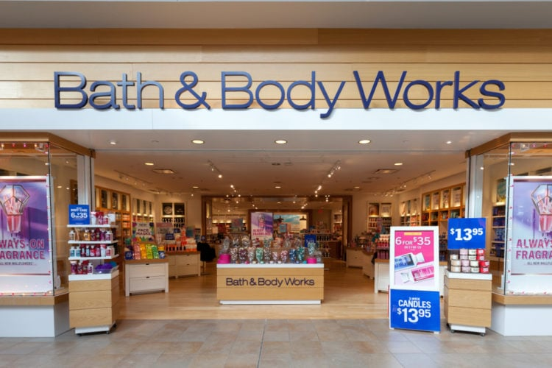
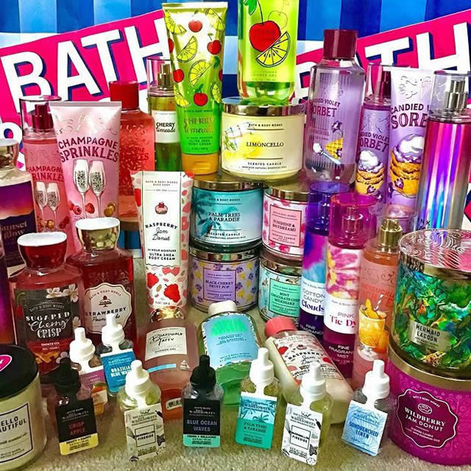
About our company
Bath & Body Works, Founded in 1990 in New Albany, Ohio, is a global leader in personal care and home fragrance, including top-selling collections for fine fragrance mist, body lotion and body cream, 3-wick candles, home fragrance diffusers and liquid hand soap. Powered by agility and innovation, the company’s predominantly U.S.-based supply chain enables it to deliver quality, on-trend luxuries at affordable prices. Bath & Body Works serves and delights customers however and wherever they want to shop, from welcoming, in-store experiences at more than 1,880 Company-operated Bath & Body Works locations in the U.S. and Canada, more than 500 international franchised locations and an online storefront at bathandbodyworks.com.

Slide 4


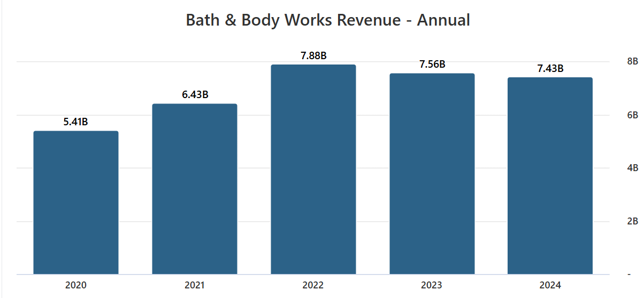
Current Market position
Annual Revenue: $7.43 billion (12 months ending Feb 3, 2024).
Quarterly Revenue: $1.61 billion in Q3 2024 (+3% YoY).
Stores: 1,850+ in U.S. & Canada, 480+ international franchises.
Customers: 38 million+ loyalty program members (+4% increase).
Average Price: $6-$30 per product, with frequent promotions.
Key Strengths: Strong brand loyalty, affordable luxury pricing, extensive retail + e-commerce presence.
Growth Areas: New product lines (men’s grooming, laundry care), digital expansion, influencer marketing.
Challenges: Rising production costs, competition in the premium segment.
Source: Bath & Body Works revenue 2023 | Statista

Slide 5

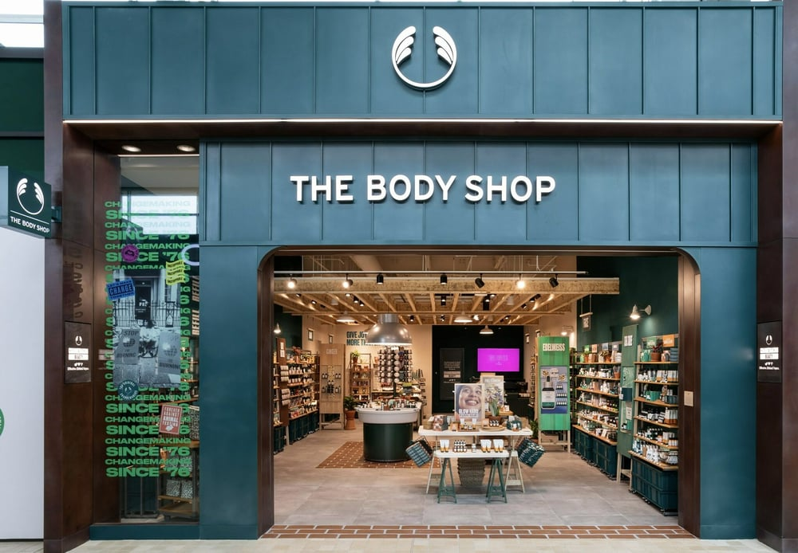
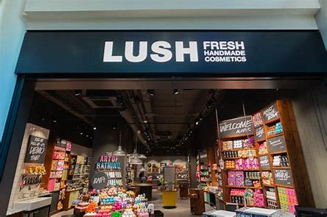
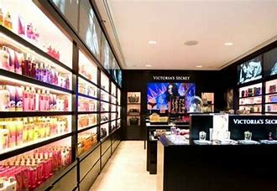
About Competitors
The Body Shop – Ethical & Sustainable Beauty
Lush – Handmade & Zero-Waste Innovation
Victoria’s Secret Beauty – Luxury & Sensual Fragrances
Founded in 1976 in the UK, The Body Shop is a pioneer in ethical beauty with a strong focus on sustainability, cruelty-free products, and fair-trade ingredients. The brand is well-known for natural skincare, bath & body products, and fragrances. Despite financial struggles and store closures, it remains a key player in the eco-conscious beauty segment.
Lush, founded in 1995 in the UK, is a premium cruelty-free and vegan beauty brand specializing in handmade skncare, bath bombs, and haircare. It stands out with its zero-packaging (naked products) approach, sustainability activism, and bold product innovations. Lush appeals strongly to Gen Z and eco-conscious consumers, though its higher price point limits mass-market reach.
As part of Victoria’s Secret, this division focuses on luxurious body mists, perfumes, and skincare. With a fashion-driven, sensual brand identity, it attracts consumers seeking feminine, seductive scents and premium beauty products. It competes in the higher-end fragrance and body care market, leveraging the VS brand’s glamour and exclusivity.

Slide 6



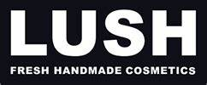

Competitor’s Market Position
The Body Shop
Lush
Victoria’s Secret
Revenue: Estimated $900 million annually (declining).
Stores: 2,500+ worldwide but closing underperforming locations.
Customers: Primarily eco-conscious, younger demographics.
Average Price: $10-$40, positioned as a sustainable & ethical brand.
Key Strengths: Strong sustainability & cruelty-free positioning, fair trade sourcing.
Growth Areas: Expanding refill stations, vegan-certified products.
Challenges: Financial struggles, store closures, increasing competition from newer sustainable brands.
Revenue: Around $1.2 billion globally.
Stores: 900+ worldwide.
Customers: Vegan, sustainability-focused audience, strong Gen Z appeal.
Average Price: $7-$50, premium handmade & organic products.
Key Strengths: Unique, innovative product formats (bath bombs), anti-packaging initiatives, strong brand activism.
Growth Areas: Expansion in zero-waste products, immersive in-store experiences.
Challenges: Higher price point, competition from emerging indie sustainable brands.
Revenue: Beauty & fragrance division estimated at $1 billion+.
Stores: Sold in 800+ Victoria’s Secret stores & online.
Customers: Women, premium segment, fashion-oriented buyers.
Average Price: $10-$60, positioned as luxury & sensual beauty.
Key Strengths: Strong brand association with fashion, premium scent offerings, bundled gift sets.
Growth Areas: Expanding luxury fragrance lines, celebrity collaborations.
Challenges: Strong competition from niche perfume brands, shift toward clean beauty trends.

Slide 7


Comparison
Brand | Positioning | Strengths | Challenges
Bath & Body Works | Affordable luxury | Strong fragrances, brand loyalty, promotions | Sustainability concerns, pricing perception
The Body Shop | Ethical & Natural Beauty | Cruelty-free, vegan, eco-friendly | Less variety in fragrances
Victoria's Secret | Premium, Sensual Fragrances | Strong branding, luxury appeal | Expensive, limited body care range
Lush | Handmade, Natural, Sustainable | Eco-conscious, fresh & unique products | High price, niche audience

Slide 8
Survey Methodology & Attributes
We conducted the survey using Google Forms to gather consumer insights efficiently.
The survey was distributed online to reach a diverse set of respondents.
The survey received around 70 responses from participants.
Perceptual Data Collection:
Consumers were asked to rate Bath & Body Works and its competitors on key attributes using a 1-7 scale comparing with the competitors.
Attributes analyzed included:
Fragrance Quality
Price Value
Packaging Appeal
Product Variety
Brand Image
Preference Data Collection:
Questions were designed to understand consumer preferences and purchasing behavior, including:
Overall preference rating for Bath & Body Works vs. competitors.
Willingness to pay more for BBW products over competitors (Yes/No/Maybe).
Likelihood to recommend Bath & Body Works (Yes/No/Maybe).

Slide 9
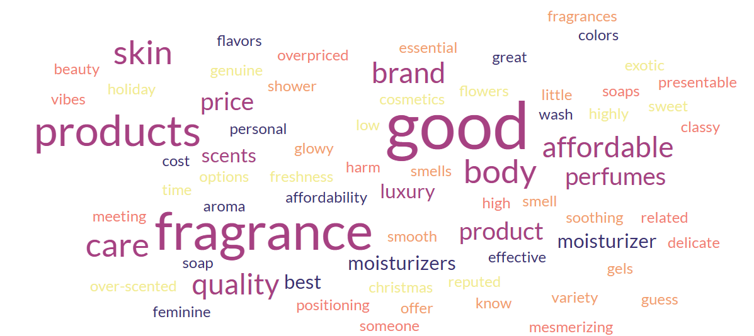
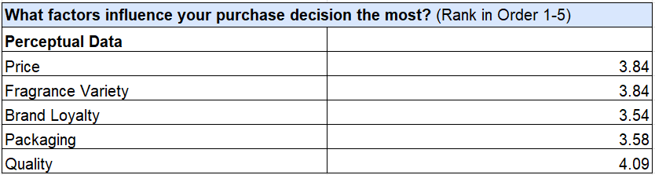

Survey Findings
Demographic Data
Perceptual Data
Strong Brand Awareness – 95.9% know Bath & Body Works, mainly seen as high quality (60.3%) and affordable (53.4%).
Positive Competitive Standing – Rated favorably (5-6 on a 7-point scale), excelling in product variety, fragrance quality, and packaging appeal, but price value is a weaker point.
Mixed Price Sensitivity – 43.8% won’t pay more, while 39.7% might, showing some pricing flexibility.
The survey had 73 respondents with a balanced gender ratio (52.1% male, 47.9% female), primarily young adults (18-24 years: 58.9%), and a geographic concentration in Tempe, Arizona (35.6%) with notable responses from India (9.6%).
A majority (54.8%) shop for personal care/fragrance products monthly, while 35.6% shop weekly, indicating a high engagement in the category.
What comes to mind when you think of Bath & Body Works?

Slide 10
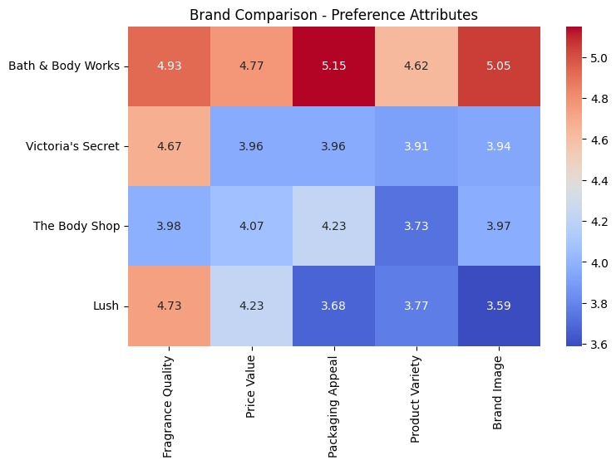
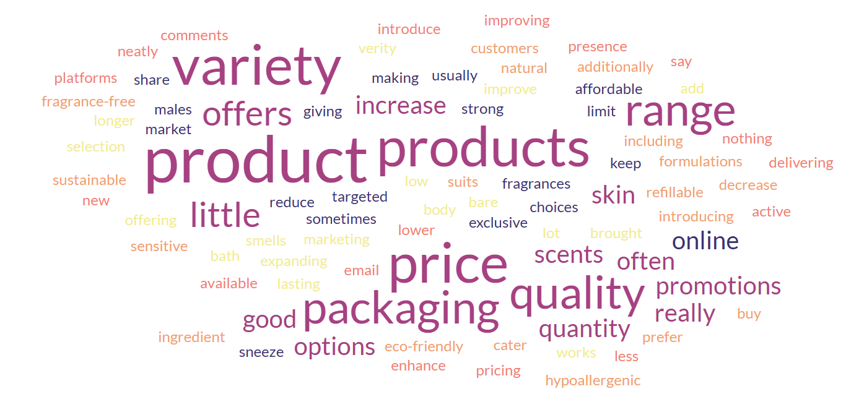
Survey Findings
Preferences Data
Strong In-Store Preference & Product Focus – 67.1% prefer shopping in-store, with body care (71.2%) and fragrances (20.5%) being the most purchased categories.
Key Purchase Drivers & Promotions – Quality is the top purchase driver, followed by fragrance variety and brand loyalty. "Buy 1 Get 1 Free" (58.9%) is the most effective promotion.
Positive Brand Perception & Recommendation – Majority (78.1%) would recommend Bath & Body Works, with most rating it 5-7 against competitors, reflecting strong brand favorability.
What do you think Bath & Body Works can improve in its product offering? (Short Answer)

Slide 11
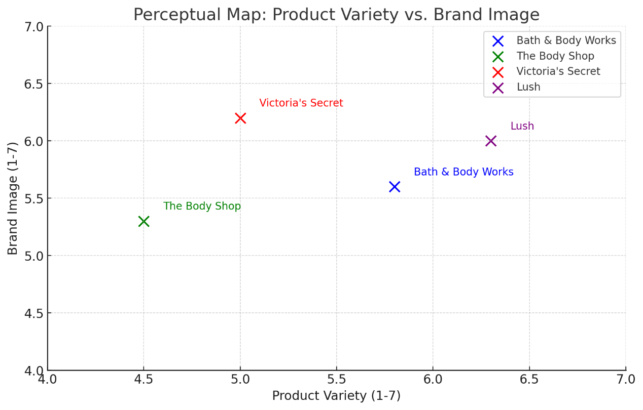
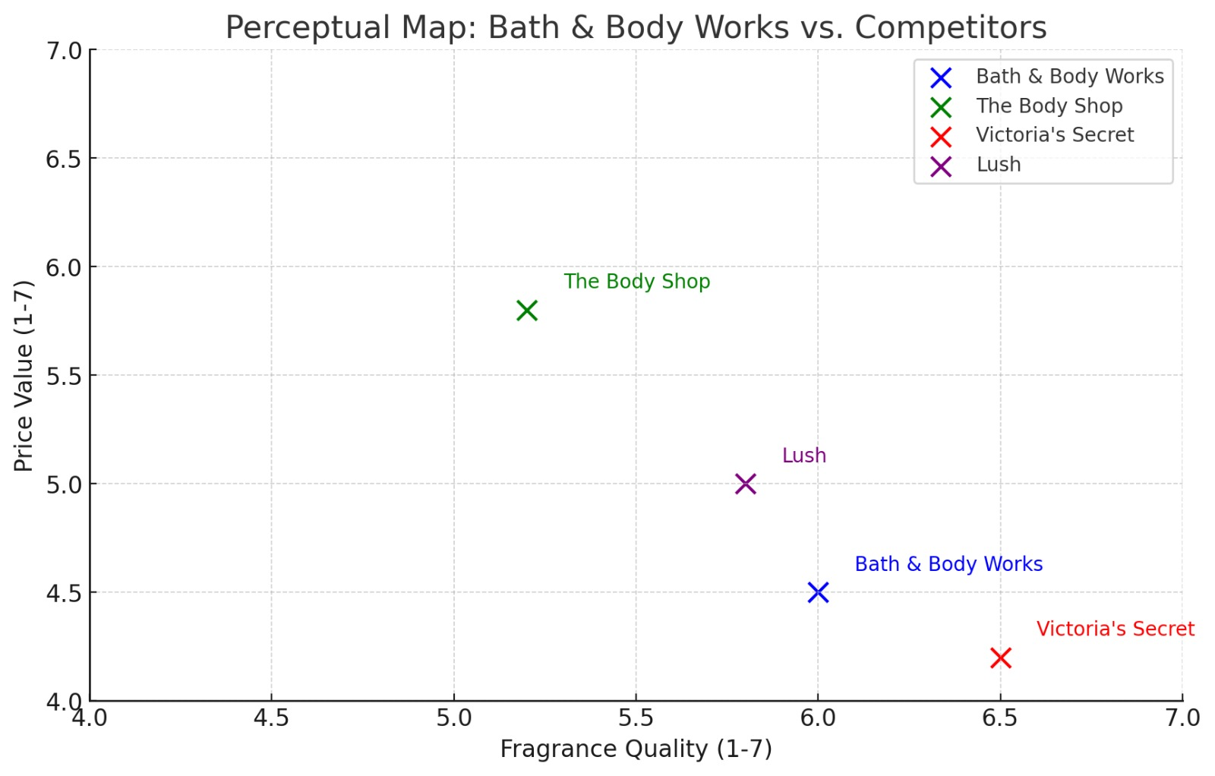
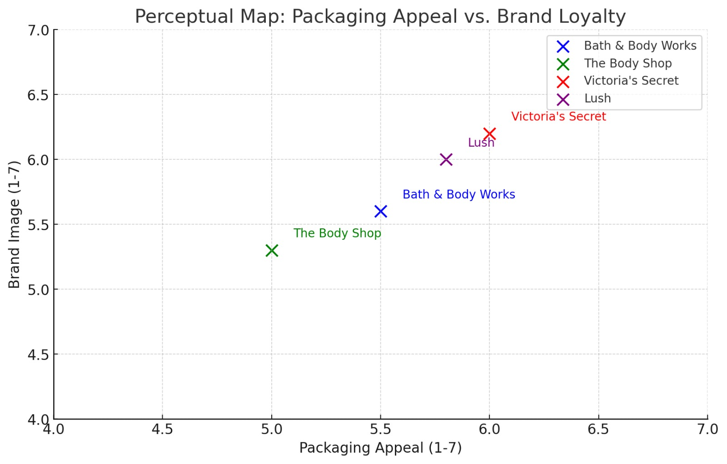
Survey Findings
Victoria’s Secret has a premium image with strong packaging appeal, while Bath & Body Works has a strong presence but slightly lower appeal. Lush stands out for sustainability with moderate packaging appeal, whereas The Body Shop focuses on natural beauty with lower appeal.
Victoria’s Secret excels in fragrance quality but lacks in price-value, while Bath & Body Works is strong in fragrance but trails The Body Shop in value. The Body Shop offers better value but lower fragrance quality, whereas Lush balances both, appealing to eco-conscious consumers.
Lush excels in variety and brand image, while Bath & Body Works dominates both. Victoria’s Secret has a high image but a limited range, whereas The Body Shop focuses on skincare with lower variety but a solid image.

Slide 12

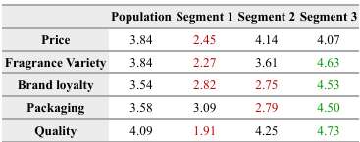
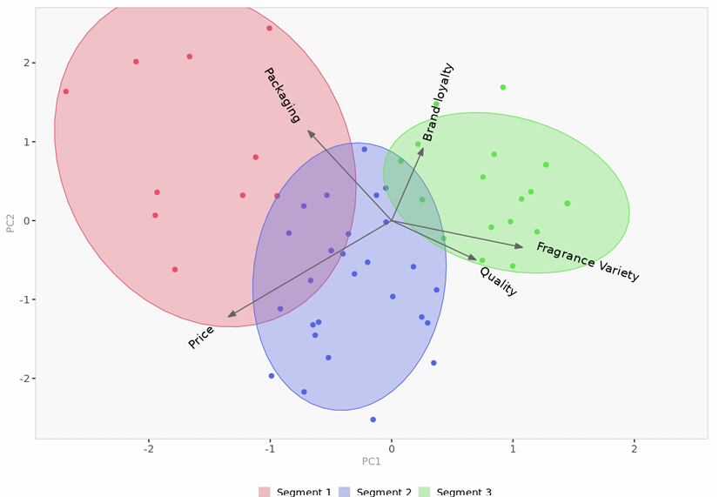

Segmentation Analysis
Segment 1 (Price-Sensitive - Red): Prioritizes price over quality and fragrance variety. Less brand loyal, likely to switch for deals. Threat: Victoria’s Secret (frequent promotions).
Segment 2 (Balanced - Blue): Values a mix of fragrance variety, brand loyalty, and packaging. Open to new brands but appreciates consistency. Threat: The Body Shop (ethical, mid-range pricing).
Segment 3 (Premium - Green): Highly values quality, fragrance variety, and brand loyalty. Prefers exclusivity and premium packaging. Threat: Lush (natural, high-quality appeal).
Bath & Body Works Positioning: Strong in fragrance variety and quality. Needs to enhance premium lines, sustainability, and packaging to compete with Lush & The Body Shop.
Opportunities: Loyalty programs for retention, targeted promotions for price-sensitive shoppers, and exclusive collections to boost brand loyalty.
Bath & Body Works is well-positioned for quality- and fragrance-focused consumers (Segment 3) but faces competition from The Body Shop on price and Lush/Victoria’s Secret on brand loyalty and packaging appeal.

Slide 13
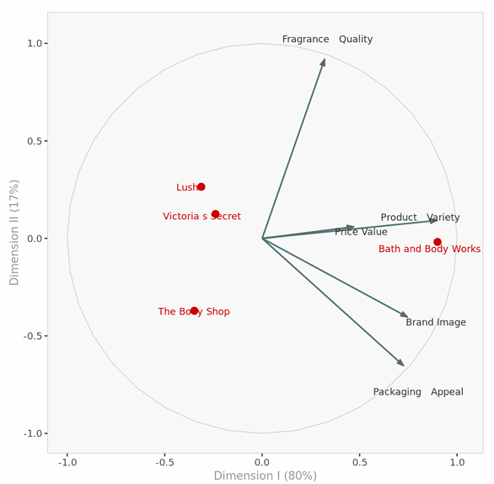
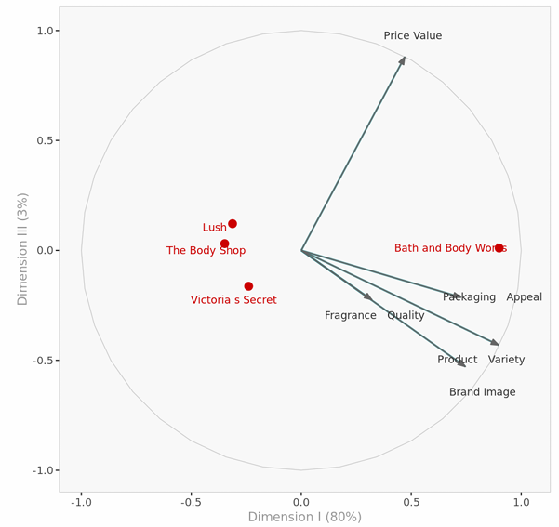
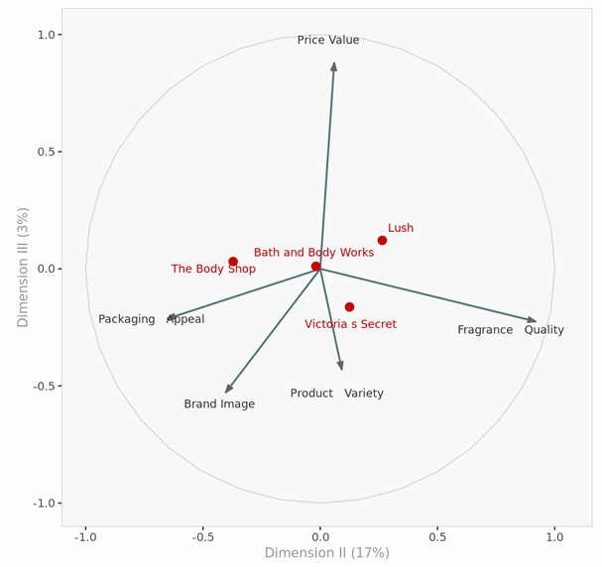
Positioning Analysis
Dimensions I – II
Bath & Body Works is strongly linked to Product Variety, Brand Image, and Packaging Appeal.
Fragrance Quality is a key driver but not strongly associated with any brand, presenting an opportunity.
Dimensions II – III
Lush stands out for Fragrance Quality, while The Body Shop emphasizes Packaging Appeal..
Bath & Body Works has a balanced perception but lacks a unique differentiator.
Dimensions I – II
Bath & Body Works is strongly linked to Product Variety, Brand Image, and Packaging Appeal.
Victoria’s Secret holds a middle-ground position, and Price Value remains independent of brand influence.
Bath & Body Works should enhance Fragrance Quality and Emotional Branding to strengthen differentiation and market positioning.

Slide 14
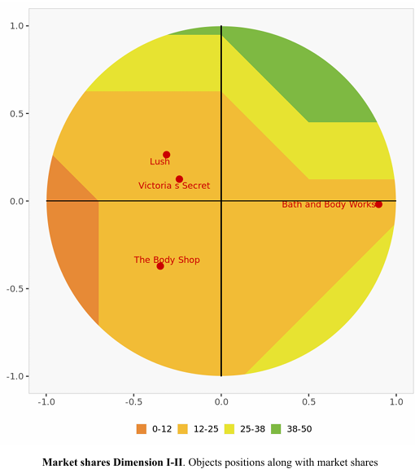
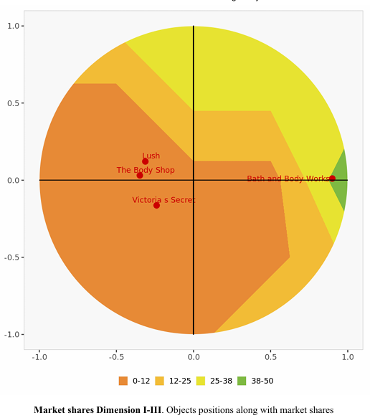
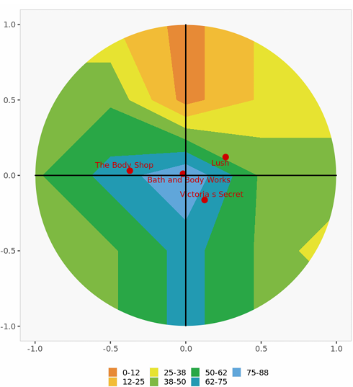
Market Share Analysis
Dimensions I – II
Bath & Body Works holds the highest market share, driven by Product Variety and Brand Image.
Lush and The Body Shop maintain moderate market presence, with Victoria’s Secret trailing behind.
Dimensions II – III
Lush has a notable market share in Fragrance Quality, while The Body Shop focuses on sustainable appeal.
Bath & Body Works is well-distributed but lacks strong dominance in a single defining attribute.
Dimensions I – II
Bath & Body Works leads in market share, benefiting from Product Variety and Packaging Appeal.
Competitors hold smaller market shares, with Victoria’s Secret having the least presence
Bath & Body Works leads in market share but needs differentiation through Fragrance Quality and Emotional Branding.

Slide 15

Limitations of the Study
Small & Skewed Sample – 73 respondents, 35.6% from Tempe, Arizona, and 58.9% aged 18-24, limiting broader market representation.
Limited Competitive & Market Scope – Only four brands analyzed, excluding niche competitors, while rapid shifts in sustainability & digital trends may affect findings.
Fragrance Quality Insight Gap – A key driver but not strongly linked to any single brand, indicating an opportunity for stronger brand association.
Potential Bias & Data Gaps – Consumer opinions may be influenced by recent purchases and promotions, with no deep dive into competitor sales & pricing strategies.
Lack of Long-Term Tracking – Single-time study limits trend assessment and requires updates for evolving consumer preferences.

Slide 16


Key Takeaways
Strong brand presence with high awareness but faces price perception challenges.
Competitive Standing: Stronger in fragrance quality than The Body Shop, competes in packaging with Victoria’s Secret, but lags Lush in sustainability.
Market Position: Well-established but lacks a unique differentiator like premium exclusivity or sustainability.
Consumer Insights: 67.1% prefer in-store shopping, and promotions drive purchases (most effective: "Buy 1 Get 1 Free").
Segmented Consumer Base:
Price-Sensitive (Threat: Victoria’s Secret) – Seeks affordability, less loyal.
Balanced (Threat: The Body Shop) – Values variety, loyalty, and ethics.
Premium (Threat: Lush) – Prefers exclusivity, sustainability, and quality.

Slide 17

Strategic Actions & Recommendations
Short-Term (0-12 Months)
Long-Term (1-3 Years)
Strengthen Fragrance Leadership – Launch seasonal & exclusive scents.
Enhance Price Perception – Offer value bundles & loyalty discounts.
Boost Retail & Digital Experience – Improve in-store engagement & targeted e-commerce promotions.
Personalized Retention – Use data-driven loyalty programs & customized marketing.
Improve Sustainability – Adopt eco-friendly packaging & ethical sourcing.
Expand Premium Offerings – Introduce luxury/niche product lines.
Strengthen Differentiation – Focus on fragrance variety, premium collections & sustainability.
Optimize Omnichannel Strategy – Integrate digital & in-store experiences with AI-driven personalization.

Slide 18


Thank you!

